Slide 1
Review Writing
By Noshaba fraz

Slide 2
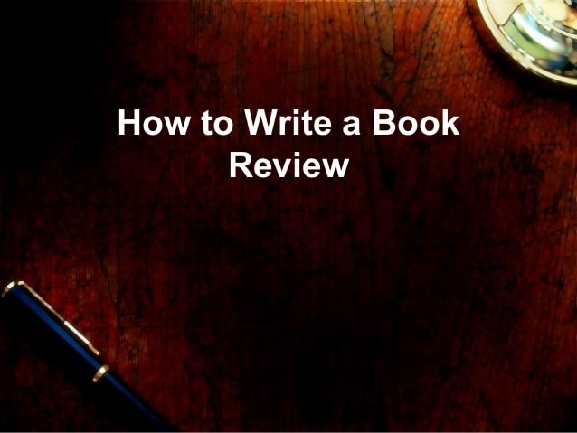

Slide 3
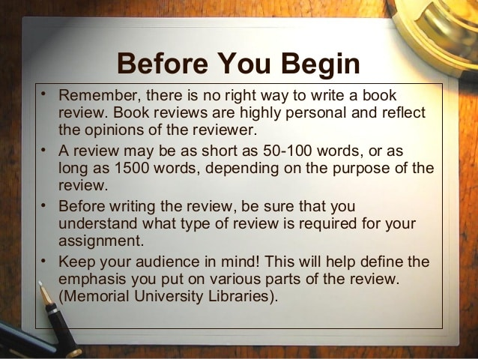

Slide 4
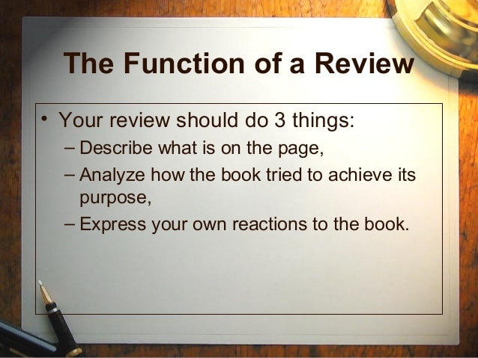

Slide 5
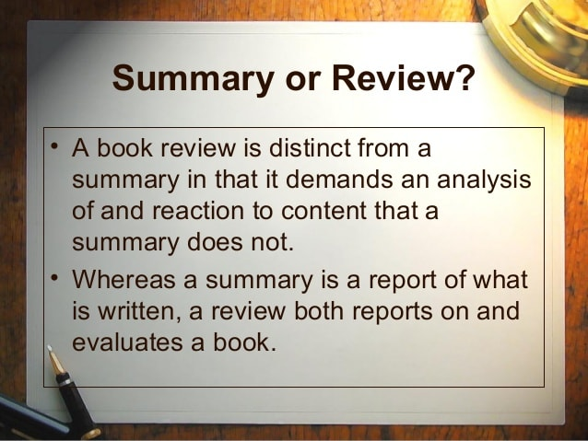

Slide 6
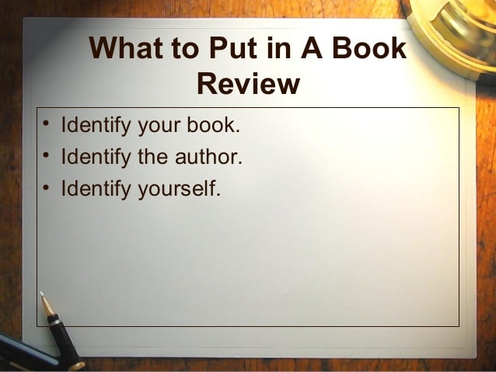

Slide 7
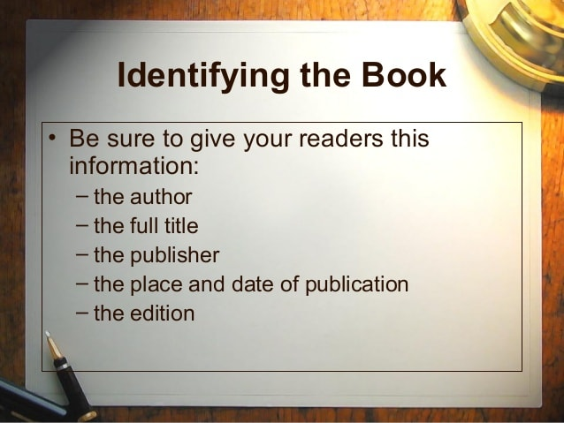

Slide 8
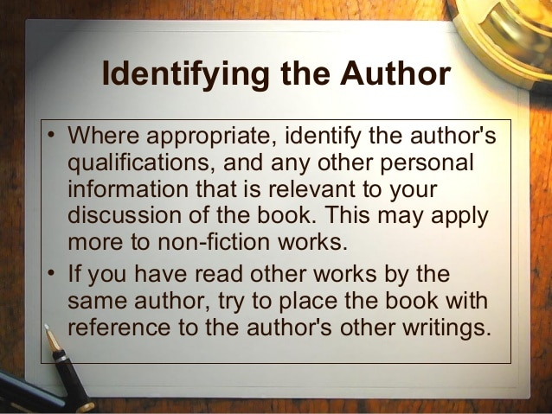

Slide 9
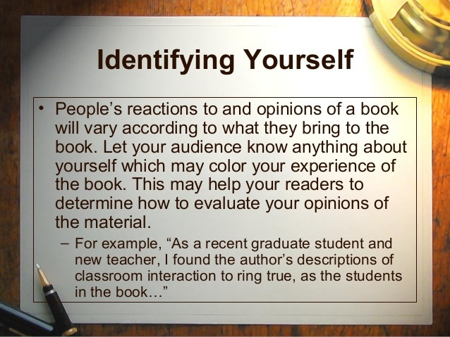

Slide 10
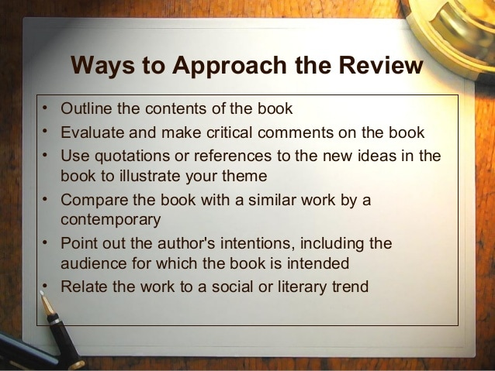

Slide 11
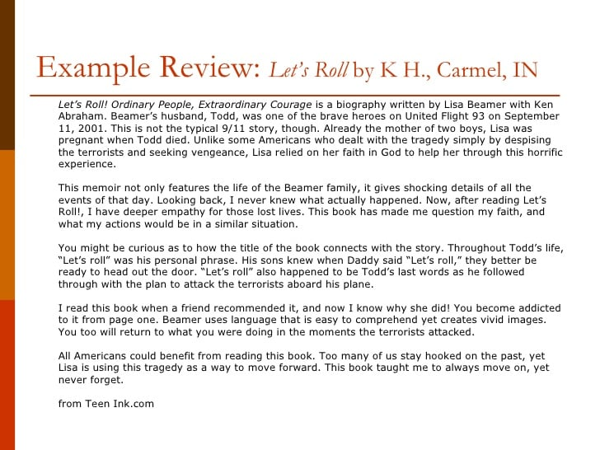

Slide 12
Review of a Movie
Mass Media Topics
Take a film. What is the message, and how does the director convey it?
Analyze a graphic novel. What is the message/passage, and how does it push the possibilities of the visual novel medium?
Observe the remake of a classic motion picture. What has changed?
Examine the influence of a popular TV series on youth.
Take Facebook. What was the initial idea? Has it grown consistently with the internet and how people use it?

Slide 13
Review of an Article
Writing Involves:
Summarization, classification, analysis, critiques, and comparison.
The analysis, evaluation, and comparison require use theories, ideas, and research, relevant to the subject area of the article.
It is also worth nothing if a review does not introduce new information, but instead presents a response to another writer’s work.
Check out other samples to gain a better understanding of how to review the article.

Slide 14
How to review an article ?
If you are wondering how to start an article review, begin with an introduction that mentions the article and your thesis for the review.
Follow up with a summary of the main points of the article.
Highlight the positive aspects and facts presented in the publication.
Critique the publication through identifying gaps, contradictions, disparities in the text, and unanswered questions.

Slide 15
Summarize the Article.
Make a summary of the article by revisiting what the author has written about. Note any relevant facts and findings from the article. Include the author's conclusions in this section.

Slide 16
Critique It.
Present the strengths and weaknesses you have found in the publication. Highlight the knowledge that the author has contributed to the field.
write about any gaps and/or contradictions you have found in the article.
Take a stand point of either supporting or not supporting the author's assertions, but back up your arguments with facts and relevant theories.

Slide 17
Craft a Conclusion
In this section, revisit the critical points of your piece, your findings in the article, and your critique. Also, write about the accuracy, validity, and relevance of the results of the article review. Present a way forward for future research in the field of study.

Slide 18
